Slide 1
Valuation of Regenerative Medicine/Advanced Therapies (RM/ATs): challenges and opportunities for creating a better framework
Adam Heathfield, Pfizer
Basel Biometric Section, Precision Medicine Seminar 4 June 2019

Slide 2
The views expressed in this presentation are in my individual capacity and do not reflect the views or official policy or position of my employer. Any strategy and possible future developments are subject to change and may be changed at any time for any reason without notice.

Slide 3
Overview
Economics of Gene Therapy and other Advanced Therapies
  Analysis from Diego Ardigo, Chiesi and Therapies Committee chair of IRDiRC
Value Frameworks for Advanced Therapies and Regenerative Medicines
  Analysis from IQVIA, ARM Foundation and CIRM project led by John Doyle (now at Pfizer)
What does this mean for Pfizer and our evidence and access planning?
  Me

Slide 4
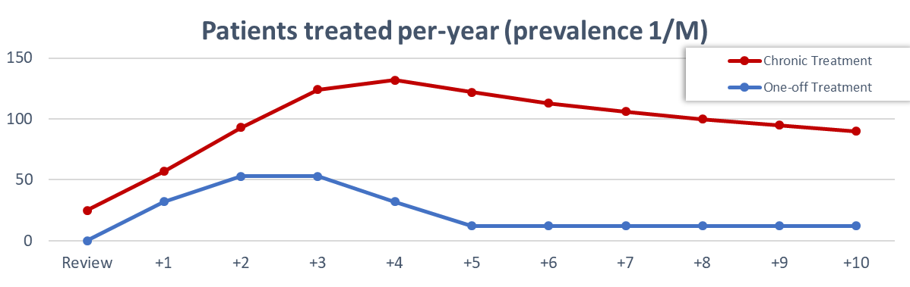
Gene Therapy vs Chronic Treatments
Patients treated over time
Key Assumptions
Prevalence = 1 / million inhabitants (~500 prevalent cases in EU)
Proportion eligible to treatment = 50%
Eligible patients undergoing treatment = 50%
Yearly incident cases = 1/10th of prevalent cases
Adherence to treatment = 85% (drop out of 15%/ year)
Prevalent cases treated within the 4th year from launch
| ATMP development sustainability | D. Ardigó | 20 Mar 2019 | PPMA2019 |

Slide 5
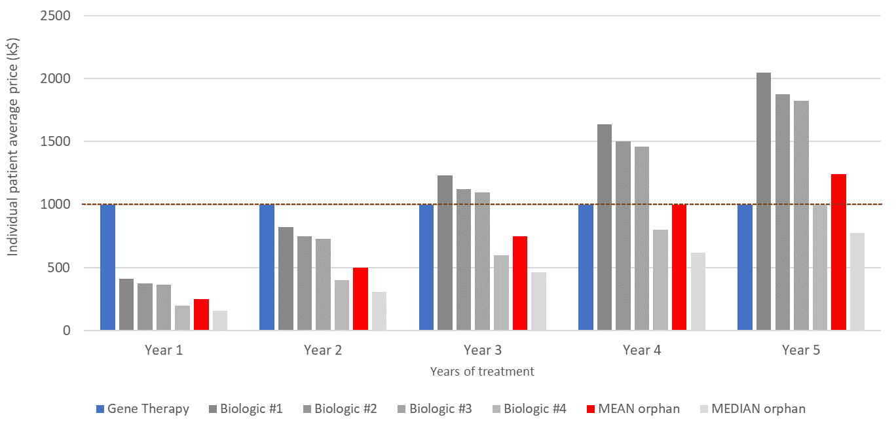
Gene Therapy vs Chronic Treatments
Spending per patient
| ATMP development sustainability | D. Ardigó | 20 Mar 2019 | PPMA2019 |

Slide 6
R.o.I. for a Hypothetical ATMP
“Fictional example with unrealistically conservative cost assumptions”
Key Assumptions
Treatments → Prevalence = 1/M; Incidence = 1/10th of prevalence; Proportion of eligible = 50%; Eligible treated = 50%; Prevalent cases treated in 4 years from launch; No commercial expenses
Research and Development → 100M € pre-approval (all inclusive) [TuftsCenter = 2.7B$; Prasad = 648M$]; 7 years development; 1M €/ year after approval
  Cost of goods = 50K €/ treatment PRICE per-patient = 100K € | 500K € | 1,000K €
DiMasi JA et al. J Health Econ. 2016 Prasad V et al. JAMA Intern Med 2017;
| ATMP development sustainability | D. Ardigó | 20 Mar 2019 | PPMA2019 |

Slide 7
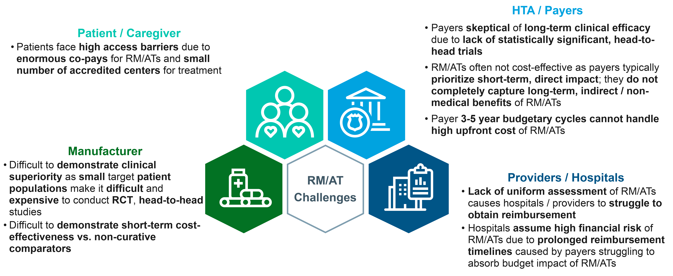
Value Frameworks for Advanced Therapies
Advanced Therapies face specific challenges to demonstrate value to stakeholders
“First of Its Kind” Economic Impact Landscape Analysis of regenerative medicine advanced therapy. CIRM, ARM Foundation, IQVIA 2019

Slide 8
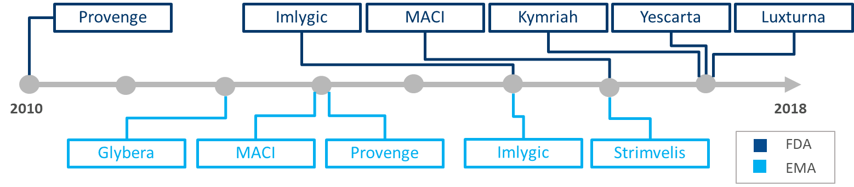
Case studies highlight some common problems
Many RM/ATs have struggled to meet market expectations due to challenges in value determination
Common challenges across RM/AT commercial success include
Stakeholder scepticism of high upfront costs of RM/AT therapies with uncertain economic value
Unclear models and inputs for economic assessments by regulators & payers
Suboptimal patient access and reimbursement schemes compared to traditional therapies
Unclear long term therapy benefit of potentially curative therapies
Adapted from “First of Its Kind” Economic Impact Landscape Analysis of regenerative medicine advanced therapy. CIRM, ARM Foundation, IQVIA 2019

Slide 9
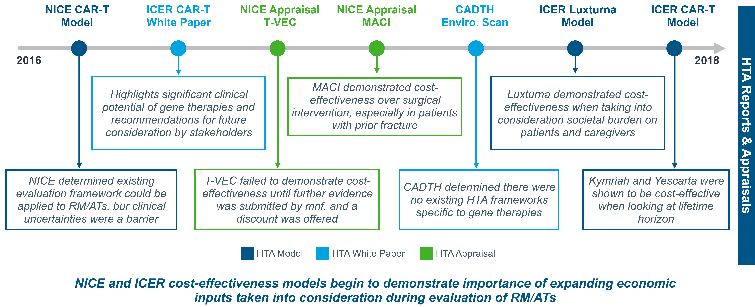
No specific value frameworks for RM/AT
Some initial appraisals and assessments of value have been conducted
“First of Its Kind” Economic Impact Landscape Analysis of regenerative medicine advanced therapy. CIRM, ARM Foundation, IQVIA 2019

Slide 10
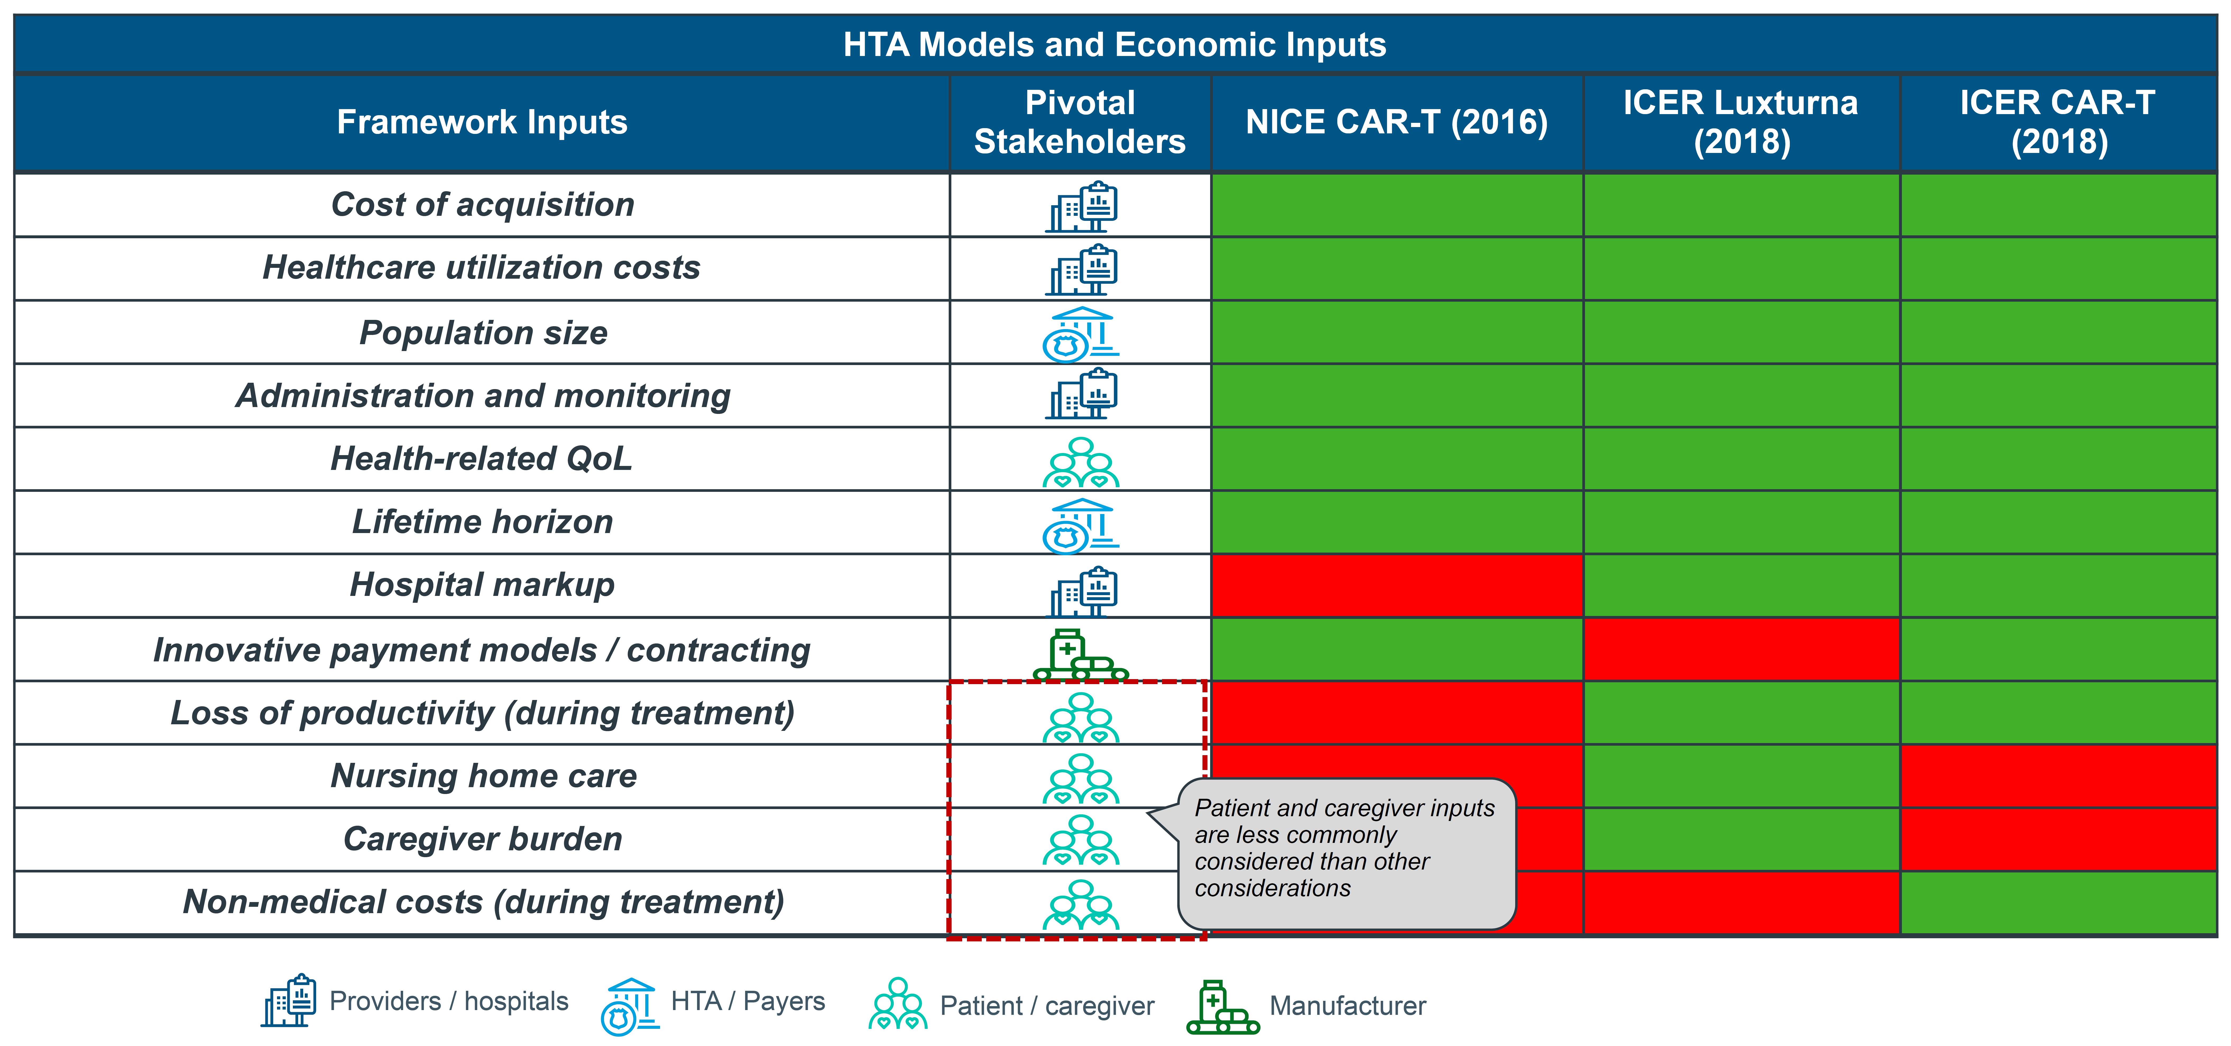
What metrics are HTAs including for RM/AT?
Emerging efforts to demonstrate value by including a more comprehensive set of metrics on economic impacts
“First of Its Kind” Economic Impact Landscape Analysis of regenerative medicine advanced therapy. CIRM, ARM Foundation, IQVIA 2019

Slide 11
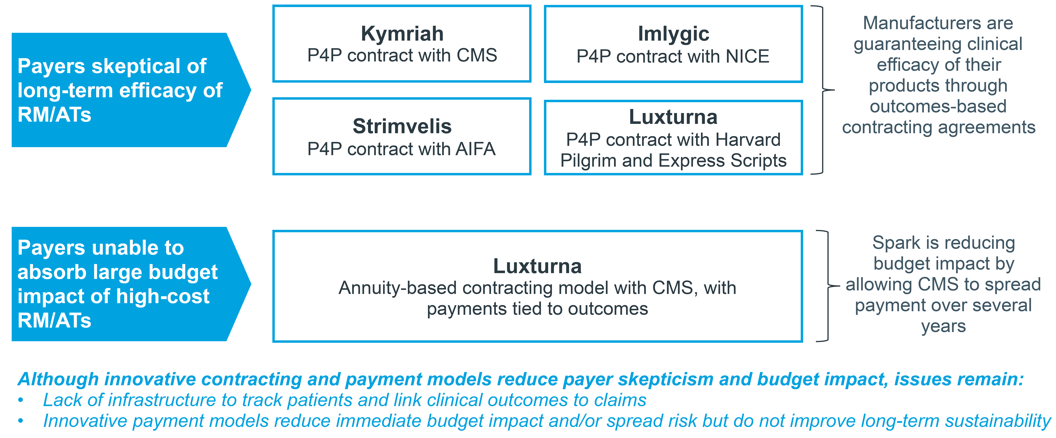
Different kinds of payment model have been critical to ensure access
Innovative payment models have been critical to help overcome HTA/payer uncertainties about high upfront costs
“First of Its Kind” Economic Impact Landscape Analysis of regenerative medicine advanced therapy. CIRM, ARM Foundation, IQVIA 2019

Slide 12
Role of real world evidence generation
Real world evidence generation will play a key role in reducing stakeholder uncertainty over long-term effectiveness and safety
Application of RWE Strategies to RM/ATs
Historical Challenges – examples include
Retrospective data analyses
Define historical treatment landscape, patient journey, burden, and generate data for SoC/comparators
RWE will characterise how product will address disease burden and fulfil gaps in treatment, differentiating it from SoC
Insufficient comparative clinical data with SoC to differentiate
Poorly established natural progression of disease
Failure to identify sub-populations where benefit may be greater
Prospective observational studies (cohort)
Track safety and effectiveness before, during and after treatment of patients
Identify potential subpopulation benefits to differentiate product
Demonstrate durability of effect and safety after launch
Historical Successes – examples include
RWE leveraged to identify natural progression of disease and burden of illness in patients
RWE used to highlight significant benefits to patients where only single arm trial data available
Registry studies
Continue to demonstrate real-world durability of effect/safety
Capture outcomes to support innovative payment models/contracting agreements
Identify potential sub-populations and follow-on indications
Adapted from: First of Its Kind” Economic Impact Landscape Analysis of regenerative medicine advanced therapy. CIRM, ARM Foundation, IQVIA 2019

Slide 13
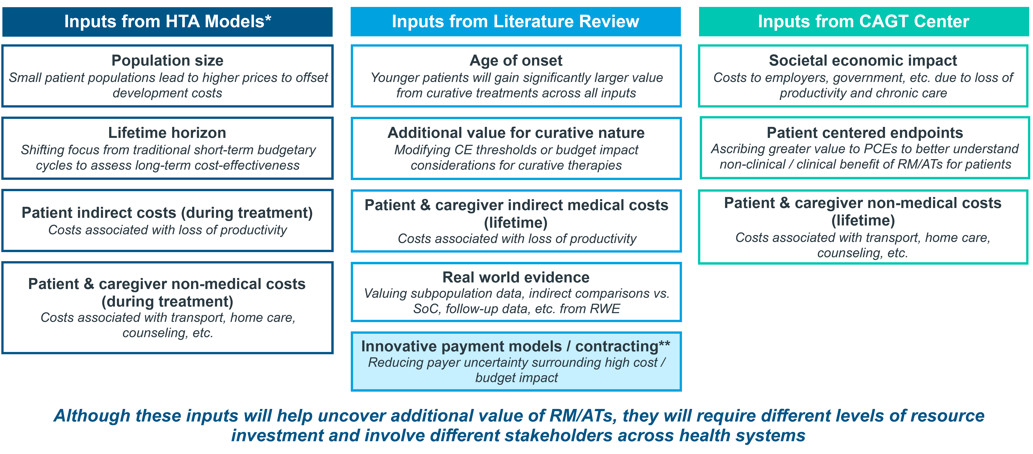
Emerging conclusions from landscape analysis
Inclusion of additional economic considerations will allow HTA/payers to better assess the net economic benefits of RM/ATs
* These inputs are derived from assessments conducted by HTAs, however they are not currently included in most HTA/payer approaches
** Will not impact value of overall product, but will reduce budget impact and improve market access
“First of Its Kind” Economic Impact Landscape Analysis of regenerative medicine advanced therapy. CIRM, ARM Foundation, IQVIA 2019

Slide 14
What does this mean for evidence and access planning?
1. For many rare diseases where RM/AT could transform lives, manufacturers will have little pricing flexibility
  Crunch times for economic viability will often be in a few early years immediately after launch
  We need to be really sure as a community that we have ways to properly and fully assess value or investment may go elsewhere
2. Landscape analysis has identified some positive changes that could be made in the following areas:
  Valuation frameworks and inclusion of new metrics including patient centric measures;
  Contracting & payment models; and
  Evidence generation, esp RWD.
3. Some issues that arise are familiar statistical and evidence quality questions around small populations and RWD. Others feel rather new and may have aspects specific to RM/AT:
  Lifetime horizon; and
  Patient end points beyond impacts on clinical measures or health system utilisation.

